Slide 1
CSE 3002- programming in java unit i
Dr. R. Manikandan
Assistant professor (senior grade)
Vit bhopal university

Slide 2
Course Objective
Creating high-performing multi-threaded applications
Creating Java technology applications that leverage the object-oriented features of the Java language, such as encapsulation, inheritance, and polymorphism
Implementing input/output (I/O) functionality to read from and write to data and text files and understand advanced I/O streams
Executing a Java technology application from the command line
Manipulating files, directories and file systems using the JDK NIO.2 specification
Creating applications that use the Java Collections framework
Performing multiple operations on database tables, including creating, reading, updating and deleting using both JDBC and JPA technology
Searching and filter collections using Lambda Expressions
Implementing error-handling techniques using exception handling
Using Lambda Expression concurrency features

Slide 3
Benefits to You
You can use this course to further develop your skills with the Java language and prepare for the Oracle Certified Professional, Java SE 8 Programmer Exam!

Slide 4
Course Syllabus

Slide 5
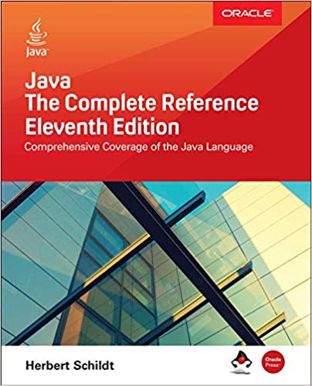
Textbook / Reference Books
TEXT BOOK
Herbert Schildt, “Java The complete reference”, 11th edition, Oracle press , 2018.

Slide 6
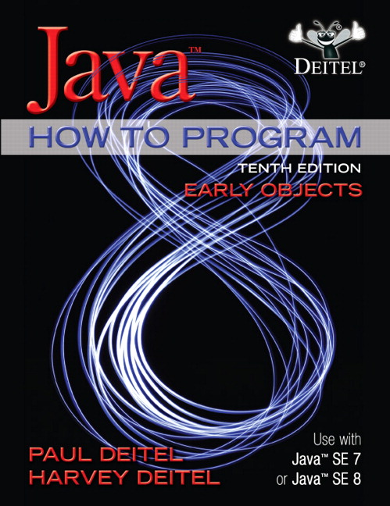
Textbook / Reference Books
REFERENCE BOOKS
Oracle University Reference E-Kit
Deitel and Deitel, “Java How to Program (Early objects)”,10thedition,Pearson, 2015
Cay S.Horstmann and Gary Cornell, “Core Java Vol I–Fundamentals”,8thedition,Pearson, 2011
Steven Holzner et al., “Java 2 Black Book”, Dreamtech press, Reprint edition 2010

Slide 7
Course Assessment Details
S.No | Name of the Component | Nos. | Marks | Remarks
1 | CAT1 | 1 | 15 | Exam will Conduct 50 Marks then convert into 15 Marks
2 | CAT2 | 1 | 15
3 | Mini Project | 1 | 10 | Periodically Evaluation will be conducted (Group Mode)
4 | Continuous Assessment | 5-10 | 15 | Individual
5 | Challenging Task | 1-5 | 10 | Individual
6 | Attendance | Based on % | 5
7 | TEE | 1 | 30 | Exam will Conduct 100 Marks then convert into 30 Marks
Total |  |  | 100

Slide 8
What do you expect out of this Course?

Slide 9
Programming Paradigm: Overview
Programming Paradigm can be classified into 3 primary types
Unstructured Programming
The most primitive of all programming languages having sequentially flow of control.
Code is repeated through out the program
Structured Programming OR Procedural Oriented Programming
Has non-sequentially flow of control.
Use of functions allows for re-use of code.
Object Oriented Programming
Combines Data & Action Together.

Slide 10
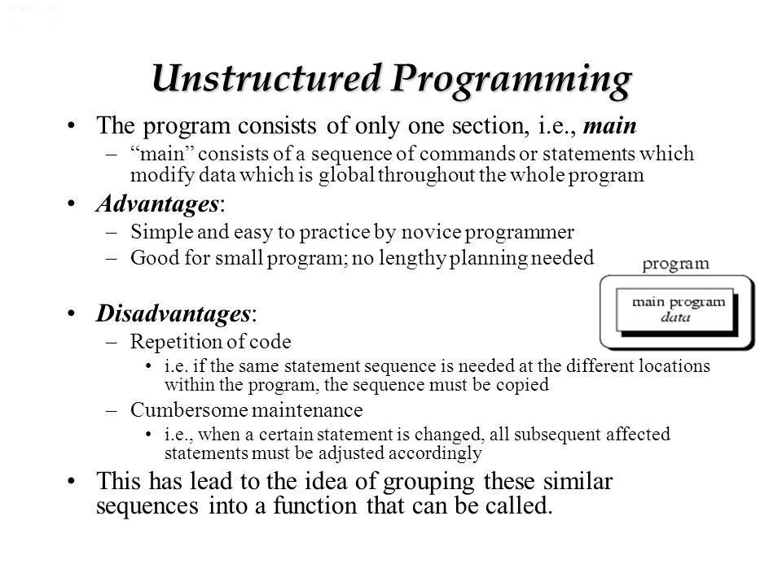
Programming Paradigm: Overview
Example: BASIC, COBOL

Slide 11
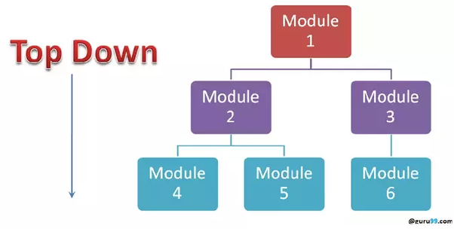
Programming Paradigm: Overview
Structured programming
Structured programming is a programming paradigm aimed at improving the clarity, quality, and development time of a computer program by making extensive use of the structured control flow constructs of selection (if/then/else) and repetition (while and for), block structures, and subroutines.
Use top down approach
In this approach, first we develop the main module and then the next level modules are developed. This procedure is continued until all the modules are developed.
Example: ALGOL, C, C++

Slide 12
Programming Paradigm: Overview
Advantages
Complexity can be reduced using the concepts of divide and conquer.
Logical structures ensure clear flow of control.
Increase in productivity by allowing multiple programmers to work on different parts of the project independently at the same time.
Modules can be re-used many times, thus it saves time, reduces complexity and increase reliability.
Easier to update/fix the program by replacing individual modules rather than larger amount of code.

Slide 13
Programming Paradigm: Overview
Structured programming
Disadvantages
Same code repetition
Lack of information hiding
Not much reusability of code.
Can support the software development projects easily up to a certain level of complexity. If complexity of the project goes beyond a limit, it becomes difficult to manage.
Change of even a single data structure in a program necessitates changes at many places throughout it, and hence the changes becomes very difficult to track even in a reasonable sized program.

Slide 14
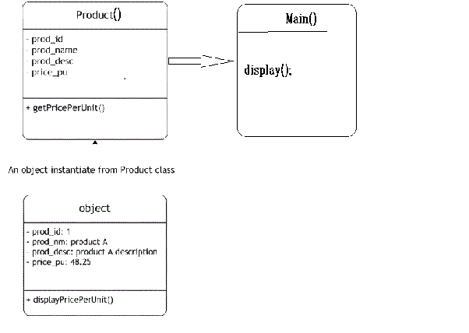
Programming Paradigm: Overview
Object Oriented programming (OOP) is programming language model organized around objects rather than "actions" and data rather than logic.
Use Bottom up approach.
start from object to data to function then to main() function for displaying result.
Example: C++, C#, Java, PHP, Python, etc

Slide 15
Programming Paradigm: Overview
Object Oriented programming
Advantages
It provides a clear modular structure for programs which makes it good for defining abstract data types in which implementation details are hidden
Objects can also be reused within an across applications. The reuse of software also lowers the cost of development. More effort is put into the object-oriented analysis and design, which lowers the overall cost of development.
It makes software easier to maintain. Since the design is modular, part of the system can be updated in case of issues without a need to make large-scale changes

Slide 16
Programming Paradigm: Overview
Advantages
Reuse also enables faster development. Object-oriented programming languages come with rich libraries of objects, and code developed during projects is also reusable in future projects.
It provides a good framework for code libraries where the supplied software components can be easily adapted and modified by the programmer. This is particularly useful for developing graphical user interfaces.
Better Productivity as OOP techniques enforce rules on a programmer that, in the long run, help us get more work done; finished programs work better, have more features and are easier to read and maintain.
OOP programmers take new and existing software objects and "stitch" them together to make new programs. Because object libraries contain many useful functions, software developers don't have to reinvent the wheel as often; more of their time goes into making the new program.

Slide 17
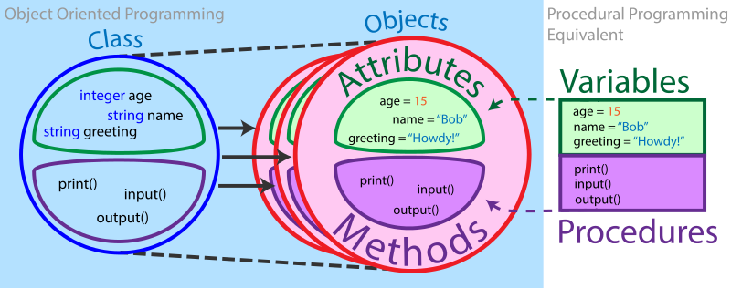
Programming Paradigm: Overview
OOPs Vs Structure or Procedural oriented Programming Paradigm

Slide 18
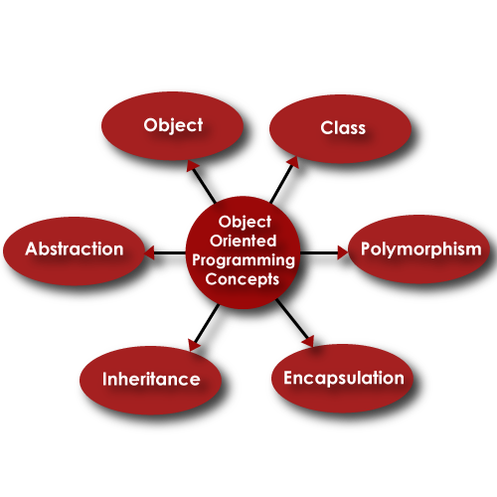
OOPs Concepts: Recap

Slide 19
OOPs Concepts: Recap
Object
Object is a real world entity, which has state, behaviour and identity .
The state of an object can be described as a set of attributes and their values.
For example, a bank account has a set of attributes such as Account Number, Name, Account Type, Balance, and values of all these attributes.
The behaviour or operation of an object refers to the changes that occur in its attributes over a period of time.
Each object has a unique identity that can be used to distinguish it from other objects. Two objects may exhibit the same behaviour and they may or may not have the same state, but they never have the same identity.

Slide 20
OOPs Concepts: Recap
Class
Class is a group of objects with similar properties, common behaviour, common relationships with other objects, and common semantics.
A class is the template / blueprint from which individual objects are created.
For example, Each bicycle was built from the same set of blueprints and therefore contains the same components.
In object-oriented terms, we say that your bicycle is an instance of the class of objects known as bicycles.

Slide 21
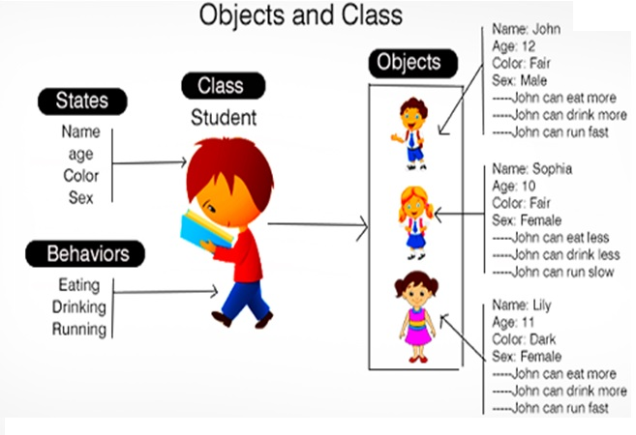
OOPs Concepts: Recap
Object & Class

Slide 22
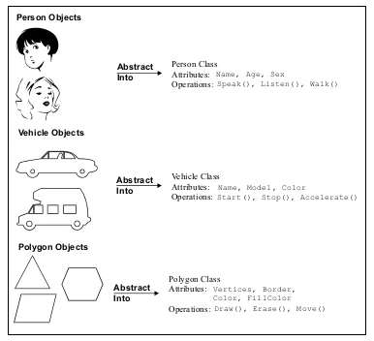
OOPs Concepts: Recap
Object & Class

Slide 23
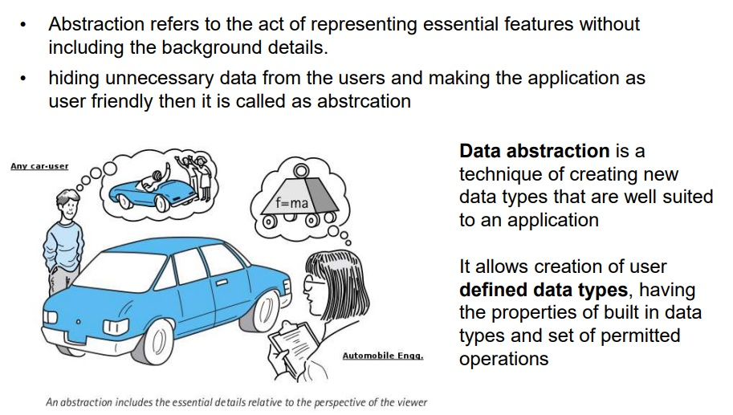
OOPs Concepts: Recap
Abstraction

Slide 24
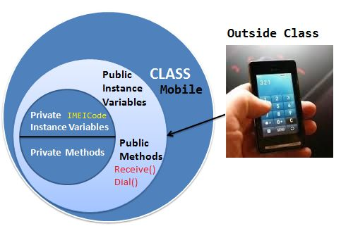
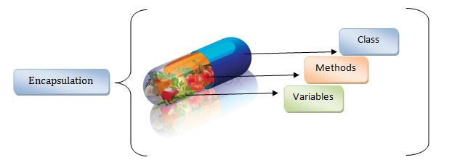
OOPs Concepts: Recap
Encapsulation
Encapsulation is defined as the process of enclosing one or more details from outside world through access right. It says how much access should be given to particular details.
Both Abstraction & Encapsulation works hand in hand because Abstraction says what details to be made visible & Encapsulation provides the level of access right to that visible details. i.e. – It implements the desired level of abstraction.

Slide 25
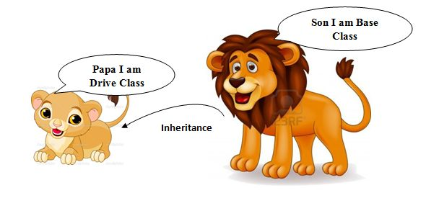
OOPs Concepts: Recap
Inheritance
Inheritance enables new objects to take on the properties of existing objects. A class that is used as the basis for inheritance is called a super class or base class. A class that inherits from a super class is called a sub class or derived class.
For example, a child inherits the traits of his/her parents. With inheritance, we can reuse the fields and methods of the existing class. Hence, inheritance facilitates Reusability and is an important concept of OOPs.

Slide 26
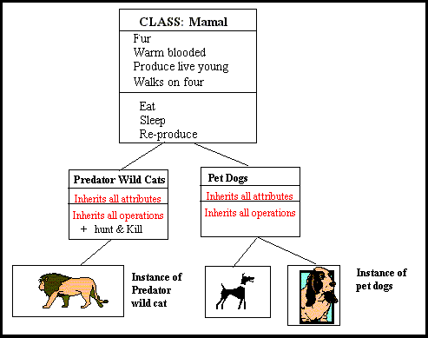
OOPs Concepts: Recap
Inheritance

Slide 27
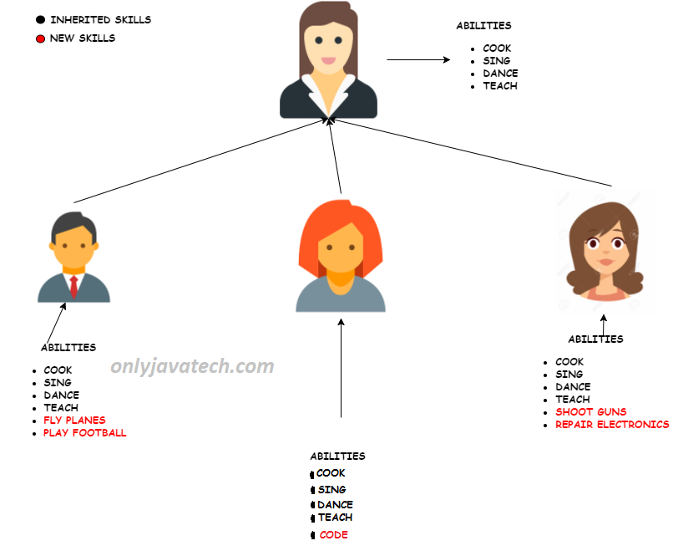
OOPs Concepts: Recap
Inheritance

Slide 28
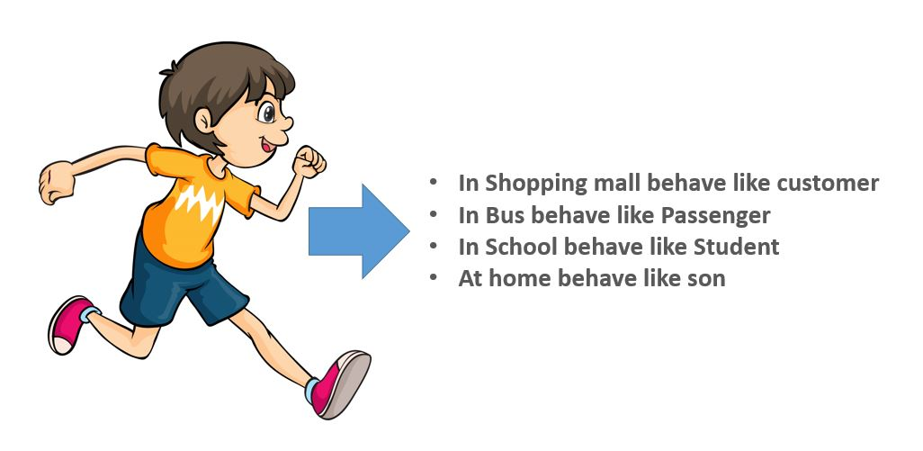
OOPs Concepts: Recap
Polymorphism
Polymorphism is the concept where an object behaves differently in different situations. There are two types of polymorphism – compile time polymorphism and runtime polymorphism.
More precisely we say it as 'many forms of single entity'. This play a vital role in the concept of OOPS.
For Example, we are turn on the phone by one button at the same time we can turn off the phone by the same button.

Slide 29
Object Oriented Programming vs. Object Based Programming
Object oriented and Object based programming languages have some different features and behaviour
Object oriented language
Object-oriented language supports all the features of OOPs.
Object-oriented language doesn't has in-built object.
Object-oriented languages are C++, C#, Java, Python, PHP etc.
Object based language
Object-based language doesn't support all the features of OOPs like Polymorphism and Inheritance
Object-based language has in-built object like JavaScript has window object.
Object-based languages are JavaScript, VB etc.

Slide 30
JAVA: Introduction
Java is an object-oriented, class-based, concurrent, secured and general-purpose computer-programming language.
Java is a platform.
Platform: Any hardware or software environment in which a program runs, is known as a platform. Since Java has a runtime environment (JRE) and API, it is called a platform.

Slide 31
JAVA: History
Java initial work started in 1990 by Sun Microsystems engineer Patrick Naughton as a part of the Stealth Project.
The Stealth Project soon changed to the Green Project, with Mike Sheridan and James Gosling joining the ranks, and the group began developing new technology for programming next-generation smart appliances.
James Gosling, Mike Sheridan, and Patrick Naughton initiated the Java language project in June 1991.
Gosling attempted to modify and extend C++ (a development he refers to as "C++ ++ --"), but quickly abandoned this approach in favour of creating an entirely new language.
Firstly, it was called "Greentalk" by James Gosling, and file extension was .gt. After that, it was called Oak, named after the tree that stood outside his office.
Notes:
Java was conceived by james gosling,patrick naughton….
Java was initially called as Oak..
But renamed as java in 1995
Standard edition, management edition, enterprise edition (used for adv.. Java concepts)
You can write the java program in any editors, notepads. But it will be easy if you use editplus

Slide 32
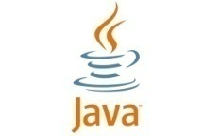
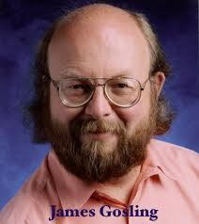
JAVA: History
Originally designed for small, embedded systems in electronic appliances like set-top boxes. Then incorporate some changes based on emergence of World Wide Web, which demanded portable programs.
In 1995, Oak was renamed as "Java" because it was already a trademark by Oak Technologies.
The first publicly available version of Java (Java 1.0) was released in 1995.
In 2006 Sun started to make Java available under the GNU General Public License (GPL). Sun Microsystems was acquired by the Oracle Corporation in 2010. Oracle continues this project called OpenJDK.
Notes:
Java was conceived by james gosling,patrick naughton….
Java was initially called as Oak..
But renamed as java in 1995
Standard edition, management edition, enterprise edition (used for adv.. Java concepts)
You can write the java program in any editors, notepads. But it will be easy if you use editplus

Slide 33
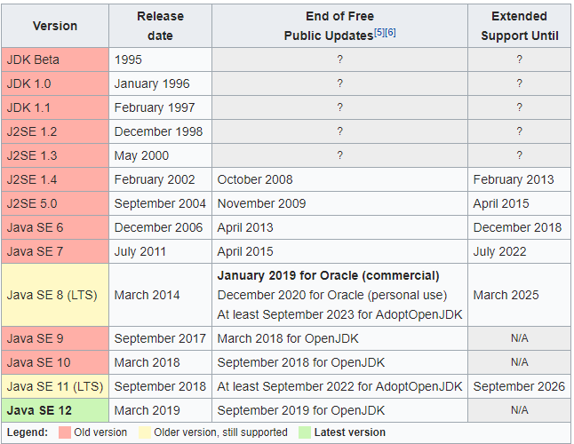
JAVA Version: History

Slide 34
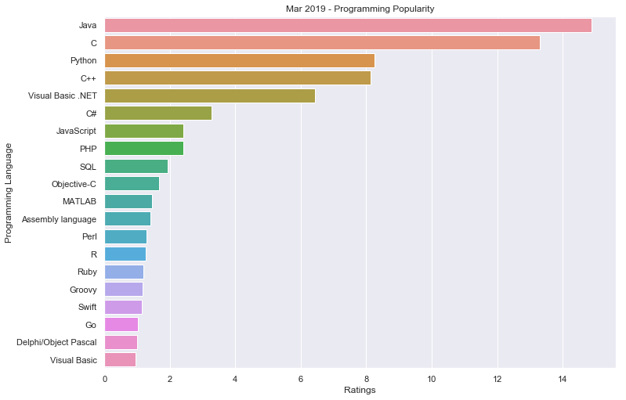
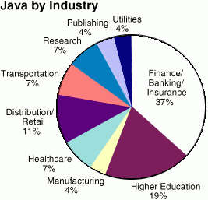
Why JAVA?
Programming Popularity (2019)
Other Comparisons
Copy-of-top-programming-languages-1.webp
top-programming-languages-1.webp
Most-pull-requests-1.webp

Slide 35
Where it is used?
850 million PCs as Java Runtime Environment
More then 3 billion devices run java
Desktop Applications such as acrobat reader, media player, antivirus etc.
Web Applications
Enterprise Applications such as banking applications.
Mobile
Web services
Cloud
Embedded System
Smart Card
Robotics
Games etc.

Slide 36
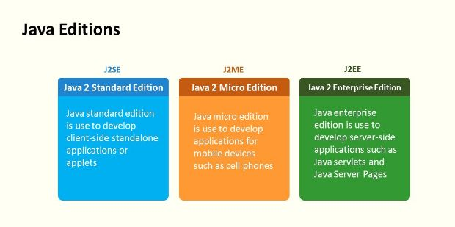
JAVA Editions

Slide 37
How JAVA is different from C?
Major difference is that C is a structure oriented language and Java is an object oriented language and has mechanism to define classes and objects.
Java does not support an explicit pointer type
Java does not have preprocessor, so we cant use #define, #include and #ifdef statements.
Java does not include structures and unions types.
Java does not include keywords like goto, sizeof and typedef.
Java adds labeled break and continue statements.
Java adds many features required for object oriented programming.

Slide 38
How JAVA is different from C++?
C++ language Features removed in java:
Java doesn’t support pointers to avoid unauthorized access of memory locations.
Java does not include structures and unions types.
Java does not support operator over loading.
Preprocessor plays less important role in C++ and so eliminated entirely in java.
Java does not perform automatic type conversions that result in loss of precision.

Slide 39
How JAVA is different from C++?
Java does not support global variables. Every method and variable is declared within a class and forms part of that class.
Java does not allow default arguments.
Java does not support inheritance of multiple super classes by a sub class (i.e., multiple inheritance). This is accomplished by using ‘interface’ concept.
It is not possible to declare unsigned integers in java.
In java objects are passed by reference only. In C++ objects may be passed by value or reference.

Slide 40
How JAVA is different from C++?
New features added in Java:
Multithreading, that allows two or more pieces of the same program to execute concurrently.
C++ has a set of library functions that use a common header file. But java replaces it with its own set of API classes.
It adds packages and interfaces.
Java supports automatic garbage collection.
break and continue statements have been enhanced in java to accept labels as targets.
The use of Unicode characters ensures portability and Internationalization.

Slide 41
How JAVA is different from C++?
Features that differ:
Though C++ and java supports Boolean data type, C++ takes any nonzero value as true and zero as false. True and false in java are predefined literals that are values for a boolean expression.
Java has replaced the destructor function with a finalize() function.
C++ supports exception handling that is similar to java's. However, in C++ there is no requirement that a thrown exception be caught.

Slide 42
Java Environment
Java includes many development tools, classes and methods
Development tools are part of Java Development Kit (JDK) and
The classes and methods are part of Java Standard Library (JSL), also known as Application Programming Interface (API).
JDK constitutes of tools like java compiler, java interpreter and many.
API includes hundreds of classes and methods grouped into several packages according to their functionality.

Slide 43
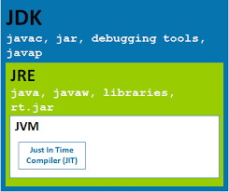
JDK VS JRE VS JVM
JDK = Java Runtime Environment (JRE) + Development Tools
JRE = Java Virtual Machine (JVM) + Library Classes

Slide 44
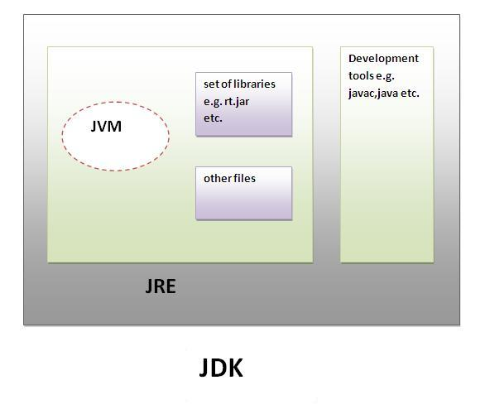
JDK VS JRE VS JVM
JDK is a software development environment used for developing Java applications and applets.
It includes the Java Runtime Environment (JRE), an interpreter/loader (Java), a compiler (javac), an archiver (jar), a documentation generator (Javadoc) and other tools needed in Java development.

Slide 45
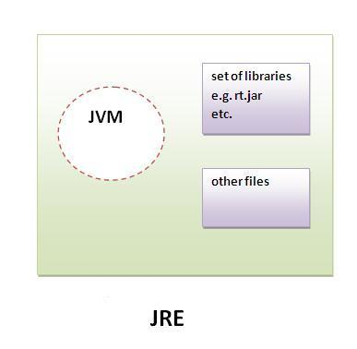
JDK VS JRE VS JVM
JRE stands for “Java Runtime Environment” and may also be written as “Java RTE.” The Java Runtime Environment provides the minimum requirements for executing a Java application; it consists of the Java Virtual Machine (JVM), core classes, and supporting files.

Slide 46
JDK VS JRE VS JVM
JVM
Java Interpreter + Just-In-Time Compiler
JVM (Java Virtual Machine) is an abstract machine. It is a specification that provides runtime environment in which java byte code can be executed.
JVMs are available for many hardware and software platforms. It is the code execution component of the Java platform.
It is a Runtime Instance Whenever you write java command on the command prompt to run the java class, an instance of JVM is created.
Note:
JVM, JRE and JDK are platform dependent because configuration of each OS differs. But, Java is platform independent.

Slide 47
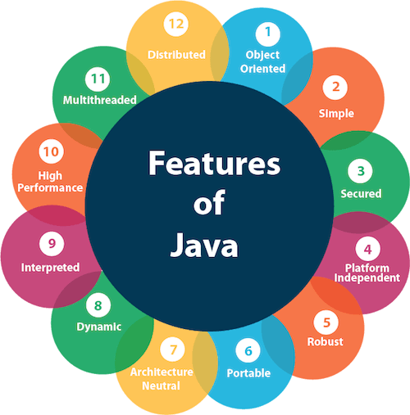
JAVA Features

Slide 48
JAVA Features
Simple
Java is very easy to learn, and its syntax is simple, clean and easy to understand.
Java syntax is based on C++ & C.
Java has removed many complicated and rarely-used features, for example, explicit pointers, operator overloading, etc.
There is no need to remove unreferenced objects because there is an Automatic Garbage Collection in Java.
Object-oriented
Java is an fully object-oriented programming language. Everything in Java is an object. Object-oriented means we organize our software as a combination of different types of objects that incorporates both data and behaviour.
It supports all the OOPs concepts

Slide 49
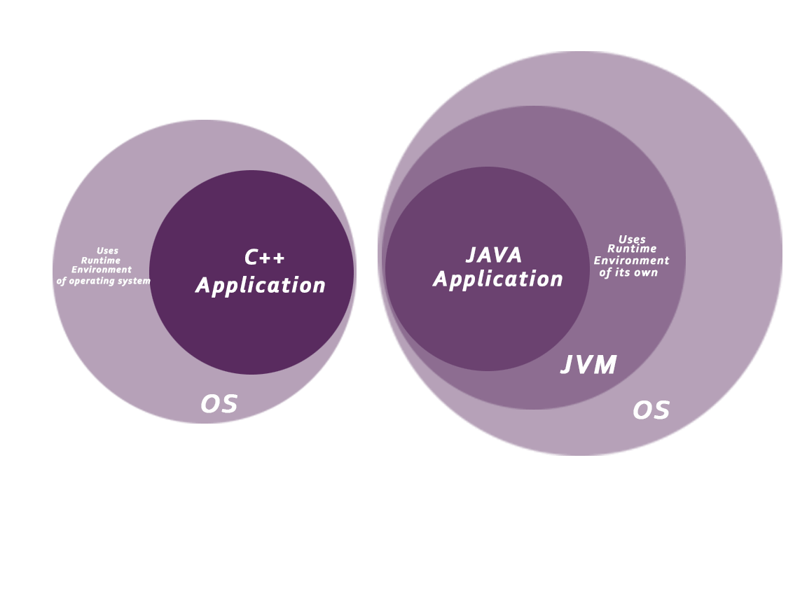
JAVA Features
Secured
Java is secured because:
No explicit pointer
Java Programs run inside a virtual machine sandbox
Classloader: Classloader in Java is a part of the Java Runtime Environment(JRE) which is used to load Java classes into the Java Virtual Machine dynamically. It adds security by separating the package for the classes of the local file system from those that are imported from network sources.

Slide 50
JAVA Features
Secured
Bytecode Verifier: It checks the code fragments for illegal code that can violate access right to objects.
Security Manager: It determines what resources a class can access such as reading and writing to the local disk.
Java language provides these securities by default. Some security can also be provided by an application developer explicitly through SSL, JAAS, Cryptography, etc.
Robust
Robust simply means strong. Java is robust because:
It uses strong memory management.
There is a lack of pointers that avoids security problems.
There is automatic garbage collection in java which runs on the Java Virtual Machine to get rid of objects which are not being used by a Java application anymore.
There are exception handling and the type checking mechanism in Java. All these points make Java robust.

Slide 51
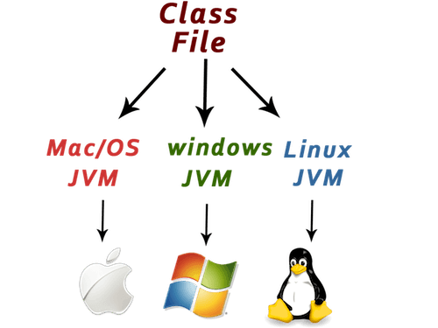
JAVA Features
Platform Independent
Java code can be run on multiple platforms, for example, Windows, Linux, Sun Solaris, Mac/OS, etc. Java code is compiled by the compiler and converted into bytecode or class file.
This bytecode is a platform-independent code because it can be run on multiple platforms, i.e., Write Once and Run Anywhere(WORA).

Slide 52
JAVA Features
Architecture-neutral
Java is architecture neutral because there are no implementation dependent features, for example, the size of primitive types is fixed.
In C programming, int data type occupies 2 bytes of memory for 32-bit architecture and 4 bytes of memory for 64-bit architecture. However, it occupies 4 bytes of memory for both 32 and 64-bit architectures in Java.
Portable
Java is portable because it facilitates you to carry the Java bytecode to any platform. It doesn't require any additional implementation.
High-performance
Java is a little bit slower than a compiled language (e.g., C++). Java is an compiled and interpreted language that is why it is slower than compiled languages, e.g., C, C++, etc.
But with the use of Just-In-Time compilers, Java enables high performance than C, C++, etc.

Slide 53
JAVA Features
Dynamic
Java is a dynamic language. It supports dynamic loading of classes. It means classes are loaded on demand. It supports dynamic compilation and automatic memory management (garbage collection).
Distributed
Java is distributed because it facilitates users to create distributed applications in Java.
RMI and EJB are used for creating distributed applications. This feature of Java makes us able to access files by calling the methods from any machine on the internet.
Multi-threaded
A thread is like a separate program, executing concurrently. We can write Java programs that deal with many tasks at once by defining multiple threads. The main advantage of multi-threading is that it doesn't occupy memory for each thread. It shares a common memory area. Threads are important for multi-media, Web applications, etc.

Slide 54
First Java Program
For executing any java program, you need to Install the JDK if you don't have installed it, download the JDK and install it.
https://www.oracle.com/technetwork/java/javase/downloads/index.html
Create the java program using any editor like notepad, notepad++ and save with file extension .java. Ex: Simple.java
/** First Java Program **/
import java.io.*;
public class Simple
{
public static void main (String args[])
{
System.out.println(“Hello World\n”);
} //end main
}//end class

Slide 55
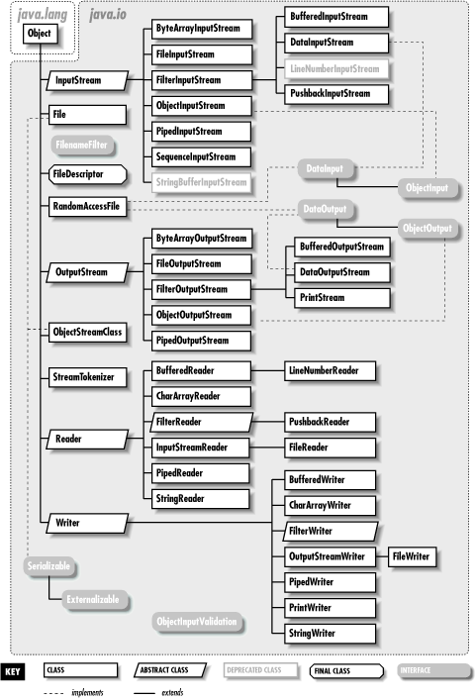
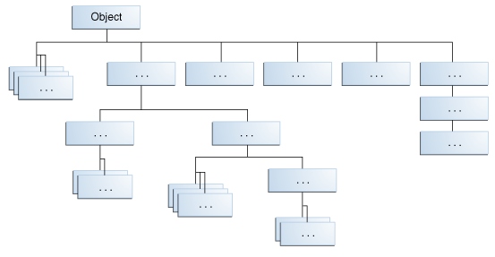
Java IO Package
https://www.oreilly.com/library/view/learning-java/1565927184/ch10.html

Slide 56
First Java Program
The path is required to be set for using tools such as javac, java, etc.
If you are saving the Java source file inside the JDK/bin directory, the path is not required to be set because all the tools will be available in the current directory.
If you have your Java file outside the JDK/bin folder, it is necessary to set the path of JDK.
There are two ways to set the path in Java:
Temporary
In Comment Prompt
set path= C:\Program Files\Java\jdk1.8.0_191\bin
Permanent
Set Path using Environmental Variables option

Slide 57
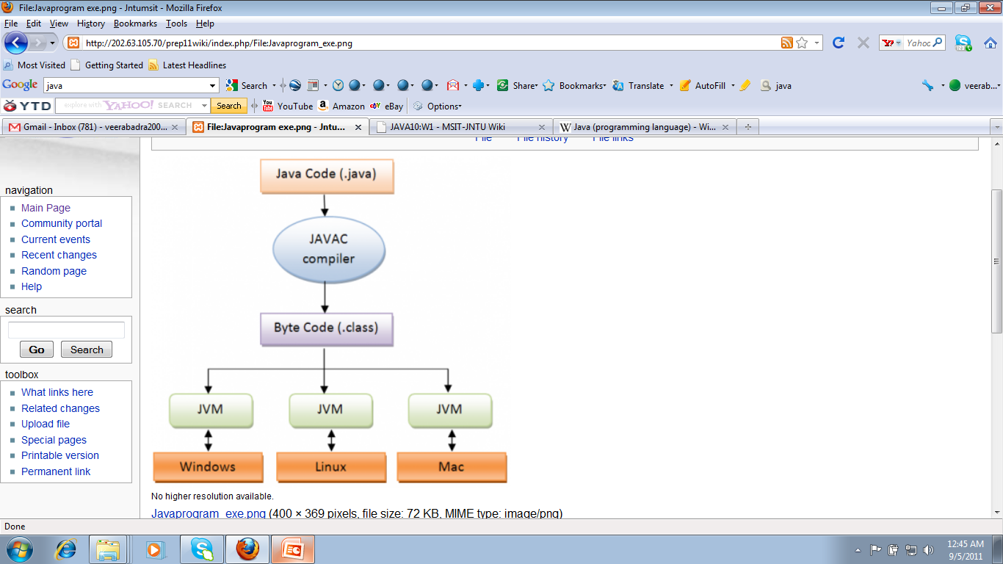
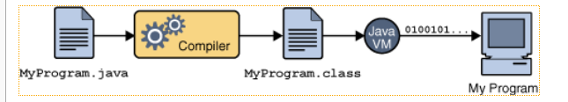
First Java Program
Compile and run the java program
To compile:
Javac Simple.java
To run:
java Simple

Slide 58
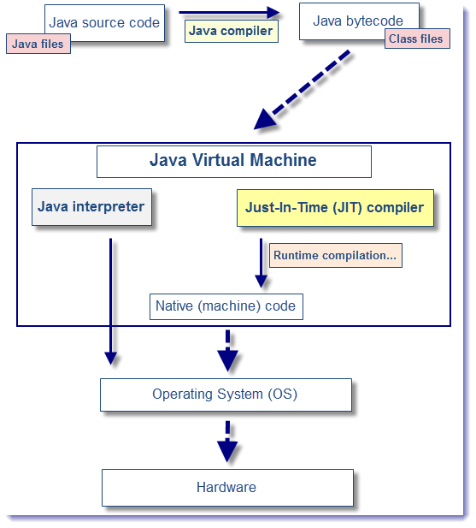
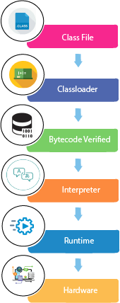
First Java Program: JVM & JIT

Slide 59
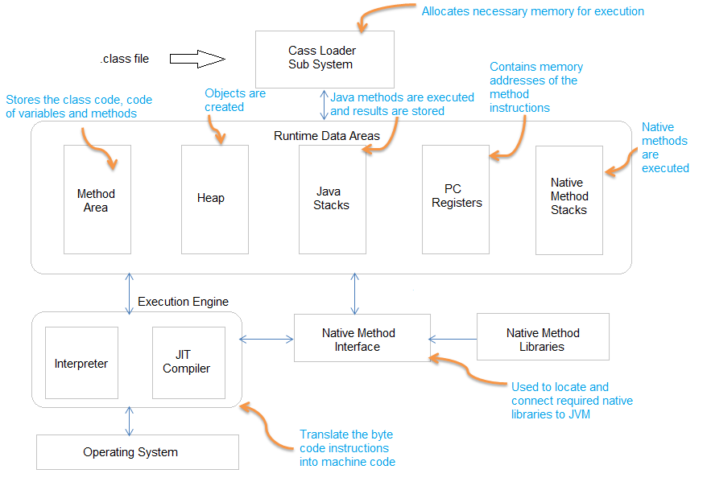
First Java Program: JVM

Slide 60
First Java Program: JIT
The Just-In-Time (JIT) compiler is a component of the runtime environment that improves the performance of Java applications by compiling byte codes to native machine code at run time.
The JIT compiler is enabled by default. When a method has been compiled, the JVM calls the compiled code of that method directly instead of interpreting it. Theoretically, if compilation did not require processor time and memory usage, compiling every method could allow the speed of the Java program to approach that of a native application.
More Details
https://www.ibm.com/support/knowledgecenter/en/SSYKE2_8.0.0/com.ibm.java.vm.80.doc/docs/jit_overview.html

Slide 61
First Java Program
/** First Java Program **/
import java.io.*;
public class Simple
{
public static void main (String args[])
{
System.out.println(“Hello World\n”);
} //end main
}//end class
QA:
Is necessary main class is public in java?
Is necessary main class name should be same as filename?
Why java main method is static and public?

Slide 62
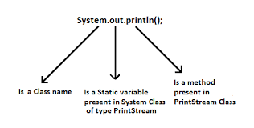
First Java Program: main method
public static void main (String args[]) {
System.out.println(“Hello World\n”);
}
Explanation:
class keyword is used to declare a class in java.
public keyword is an access modifier which represents visibility, it means it is visible to all.
static is a keyword, if we declare any method as static, it is known as static method.
The core advantage of static method is that there is no need to create object to invoke the static method.
The main method is executed by the JVM, so it doesn't require to create object to invoke the main method. So it saves memory.
void is the return type of the method, it means it doesn't return any value.
main represents startup of the program.
String[] args is used for command line argument.
System.out.println() is used print statement.

Slide 63
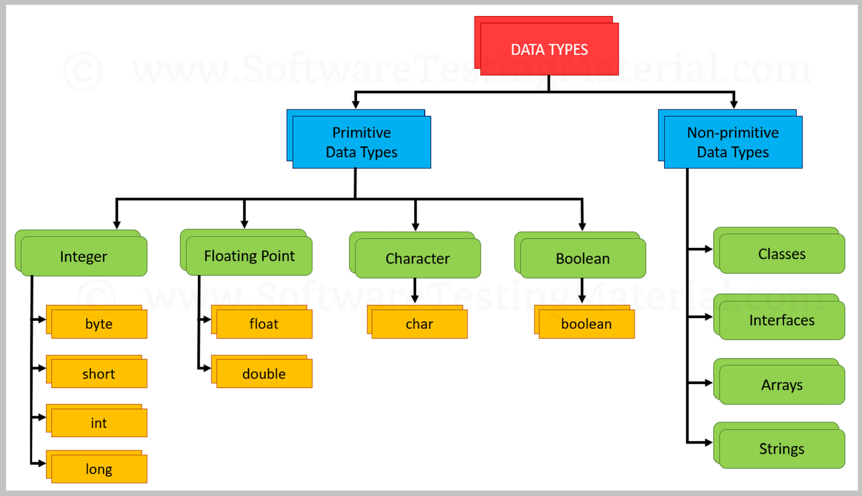
Basics of JAVA: Data Types
Data types specify the different sizes and values that can be stored in the variable.
Java is a strongly typed language
all variables must be declared before its use. That is why we need to declare variable's type and name.
There are two types of data types in Java:

Slide 64
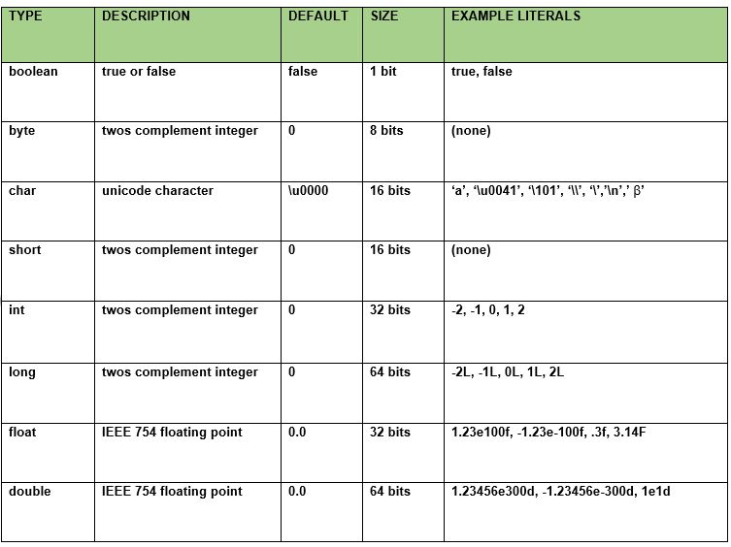
Basics of JAVA: Data Types

Slide 65
Basics of JAVA: Variables
The variable is the basic unit of storage in a Java program. A variable is defined by the combination of an identifier, a type, and an optional initializer.
In addition, all variables have a scope, which defines their visibility, and a lifetime.
There are three types of variables in java:
Local Variable
A variable declared inside the body of the method is called local variable. You can use this variable only within that method and the other methods in the class aren't even aware that the variable exists.
A local variable cannot be defined with "static" keyword.

Slide 66
Basics of JAVA: Variables
Instance Variable or Non-static variable
A variable declared inside the class but outside the body of the method, is called instance variable. It is not declared as static.
Instance variables are created when the objects are instantiated and therefore they are associated with the objects.
Static variable or Class variable
A variable which is declared as static is called static variable. It cannot be local. You can create a single copy of static variable and share among all the instances of the class.
Memory allocation for static variable happens only once when the class is loaded in the memory.

Slide 67
Basics of JAVA: Variables
Example:
class A
{
int data=50;//instance variable
static int m=100;//static variable
void method()
{
int n=90;//local variable
}
}//end of class
QA:
1. Which code fragment correctly assign a numeric literal?
byte b1 = b1011;
byte b2 = 1011b;
byte b3 = 0b1001;
byte b4 = 0xb001;
Note:
The prefix 0x or 0X indicates hexadecimal and 0b or 0B indicates binary:
// The number 26, in decimal int decVal = 26;
// The number 26, in hexadecimal int hexVal = 0x1a;
// The number 26, in binary int binVal = 0b11010;

Slide 68
Literals
A literal is the source code representation of a fixed value; literals are represented directly in your code without requiring computation.
Examples
boolean result = true;
char capitalC = 'C';
byte b = 100;
short s = 10000;
int i = 100000;
Using Underscore Characters in Numeric Literals
In Java SE 7 and later, any number of underscore characters (_) can appear anywhere between digits in a numerical literal.
This feature enables you, for example. to separate groups of digits in numeric literals, which can improve the readability of your code.

Slide 69
Literals
Examples
long creditCardNumber = 1234_5678_9012_3456L;
long socialSecurityNumber = 999_99_9999L;
float pi = 3.14_15F;
long hexBytes = 0xFF_EC_DE_5E;
long hexWords = 0xCAFE_BABE;
long maxLong = 0x7fff_ffff_ffff_ffffL;
byte nybbles = 0b0010_0101;
long bytes = 0b11010010_01101001_10010100_10010010;
You can place underscores only between digits; you cannot place underscores in the following places:
At the beginning or end of a number
Adjacent to a decimal point in a floating point literal
Prior to an F or L suffix
In positions where a string of digits is expected

Slide 70
Basics of JAVA: Unicode
Unicode is a universal international standard character encoding that is capable of representing most of the world's written languages.
Why java uses Unicode System?
Before Unicode, there were many language standards:
ASCII (American Standard Code for Information Interchange) for the United States.
ISO 8859-1 for Western European Language.
KOI-8 for Russian.
GB18030 and BIG-5 for Chinese, and so on.
This caused two problems:
A particular code value corresponds to different letters in the various language standards.
The encodings for languages with large character sets have variable length. Some common characters are encoded as single bytes, other require two or more byte.

Slide 71
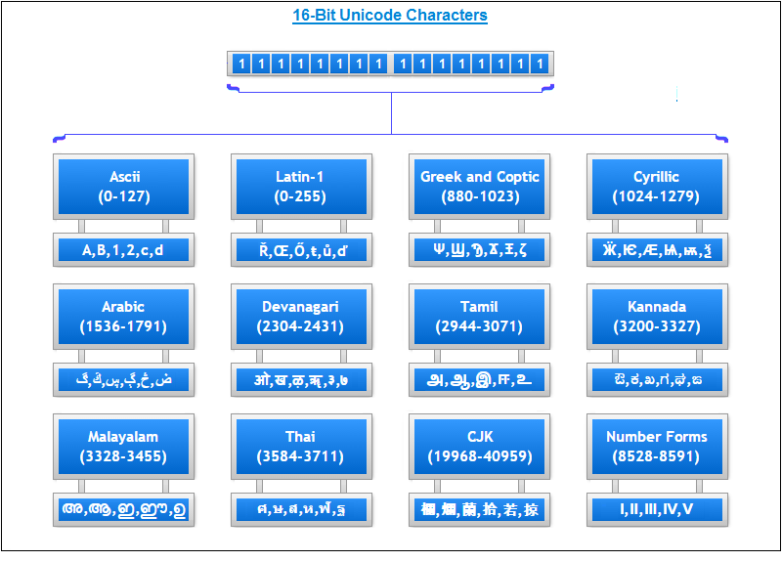
Basics of JAVA: Unicode
Solution
To solve these problems, a new language standard was developed i.e. Unicode System.
In Unicode, character holds 2 byte, so java also uses 2 byte for characters. The range of a char is 0 to 65,536
lowest value:\u0000 highest value:\uFFFF

Slide 72
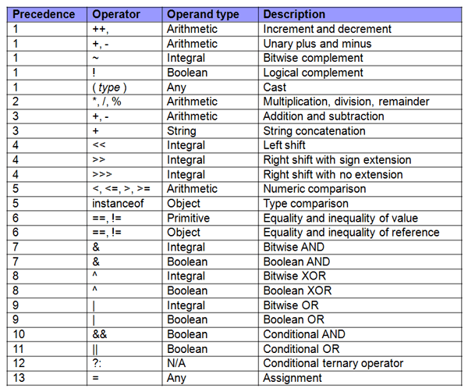
Basics of JAVA: Operators

Slide 73
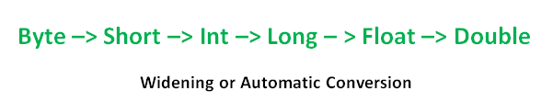
Basics of JAVA: Type Conversion
Widening or Automatic Type Conversion
Widening conversion takes place when two data types are automatically converted. This happens when:
The two data types are compatible.
When we assign value of a smaller data type to a bigger data type.
For Example, in java the numeric data types are compatible with each other but no automatic conversion is supported from numeric type to char or boolean. Also, char and boolean are not compatible with each other.
Example: Type1.java

Slide 74

Basics of JAVA: Type Conversion
Narrowing or Explicit Conversion
If we want to assign a value of larger data type to a smaller data type we perform explicit type casting or narrowing.
This is useful for incompatible data types where automatic conversion cannot be done.
Here, target-type specifies the desired type to convert the specified value to.
Example: Type2.java

Slide 75
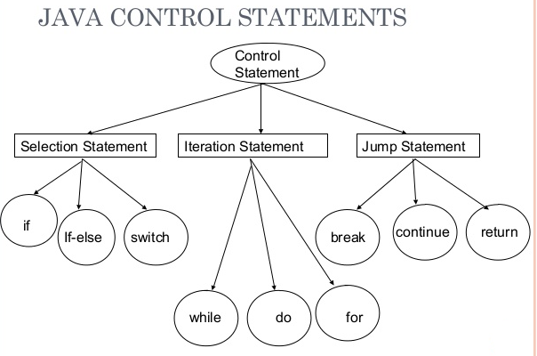
Basics of JAVA: Control Statements
There are various types of if statement in java.
if statement
if-else statement
if-else-if ladder
nested if statement
Example:
IfExample.java
IfElseExample.java
IfElseIfExample.java
NestedIfExample.java

Slide 76
Control Statements : Switch
In Java, the if..else..if ladder executes a block of code among many blocks.
The switch statement can a substitute for long if..else..if ladders which generally makes your code more readable.
It's also important to note that switch statement in Java only works with:
Primitive data types: byte, short, char and int
Enumerated types (Java enums)
String class
a few classes that wrap primitive types: Character, Byte, Short, and Integer
Example:
SwitchExample1.java, SwitchStringExample.java, NestedSwitchExample.java

Slide 77
Basics of JAVA: Wrapper class
Wrapper class in java provides the mechanism to convert primitive into object and object into primitive.
Since J2SE 5.0, autoboxing and unboxing feature converts primitive into object and object into primitive automatically.
The automatic conversion of primitive into object is known as autoboxing and vice-versa unboxing.
Need of Wrapper Classes
They convert primitive data types into objects. Objects are needed if we wish to modify the arguments passed into a method (because primitive types are passed by value).
Each class contains some useful methods
The classes in java.util package handles only objects and hence wrapper classes help in this case also.
Data structures in the Collection framework, such as ArrayList and Vector, store only objects (reference types) and not primitive types.
An object is needed to support synchronization in multithreading.

Slide 78
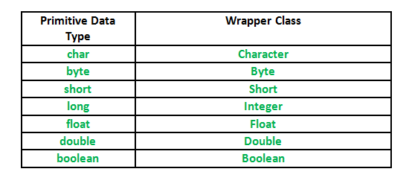
Basics of JAVA: Wrapper class
Example: WrappingUnwrapping.java

Slide 79
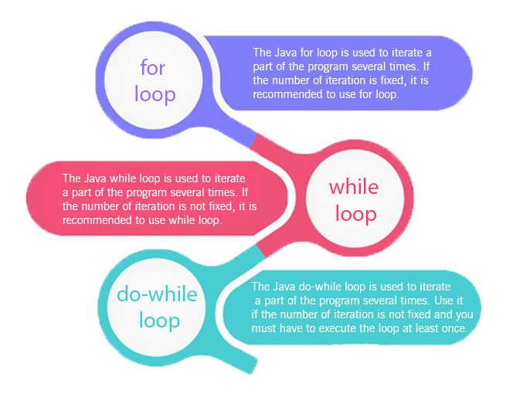
Control Statements : Loops
Loops
There are various types of for loop statement in java.
Simple For Loop
Nested For Loop
For-each or Enhanced For Loop
Labelled For Loop

Slide 80
Control Statements : Break
Break
When a break statement is encountered inside a loop, the loop is immediately terminated and the program control resumes at the next statement following the loop.
The Java break is used to break loop or switch statement. It breaks the current flow of the program at specified condition. In case of inner loop, it breaks only inner loop.
Use all types of loops such as for loop, while loop and do-while loop.
Example: BreakExample.java, BreakExample1.java, BreakExample3.java
Continue:
The continue statement is used in loop control structure when you need to jump to the next iteration of the loop immediately. It can be used with for loop or while loop.
The Java continue statement is used to continue the loop. It continues the current flow of the program and skips the remaining code at the specified condition. In case of an inner loop, it continues the inner loop only.
Use all types of loops such as for loop, while loop and do-while loop.
Example: ContinueExample.java, ContinueExample2.java, ContinueExample3.java

Slide 81
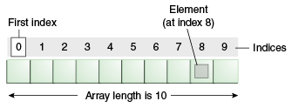
Basics of JAVA: Array
An array is a collection of similar type of elements that have a contiguous memory location.
Java array is an object which contains elements of a similar data type. It is a data structure where we store similar elements. We can store only a fixed set of elements in a Java array.
Array in java is index-based, the first element of the array is stored at the 0 index.
Advantages
Code Optimization: It makes the code optimized, we can retrieve or sort the data efficiently.
Random access: We can get any data located at an index position.
Disadvantages
Size Limit: We can store only the fixed size of elements in the array. It doesn't grow its size at runtime. To solve this problem, collection framework is used in Java which grows automatically.

Slide 82
Basics of JAVA: Array
Types of Array
There are two types of array.
Single Dimensional Array
Multidimensional Array
Single Dimensional Array in Java
Syntax to Declare an Array in Java
dataType[] arr; (or)
dataType []arr; (or)
dataType arr[];
Instantiation of an Array in Java
arrayRefVar=new datatype[size];
Example1:
int [ ] s;
s=new int[10];
Example2:
//declaration and instantiation
int s[ ]=new int[10]
Example
Testarray.java
Testarray1.java
Testarray2.java
TestAnonymousArray.java

Slide 83
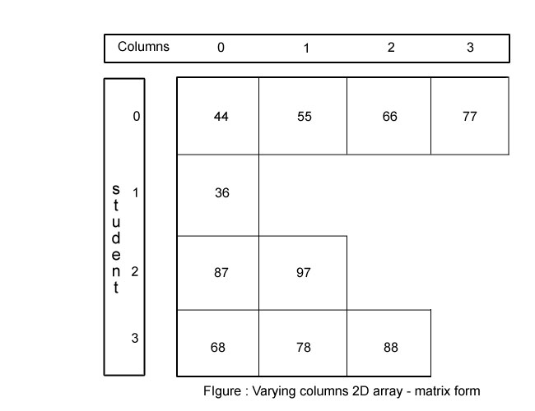
Basics of JAVA: Array
Types of Array
Multi Dimensional Array in Java
Jagged Array in Java
it is an array of arrays with different number of columns.
Syntax to Declare an Array in Java
dataType[][] arrayRefVar; (or)
dataType [][]arrayRefVar; (or)
dataType arrayRefVar[][]; (or)
dataType []arrayRefVar[];
Instantiation of an Array in Java
arrayRefVar=new datatype[row][col];
Example1:
int [ ][ ] s;
s=new int[3][3];
Example2:
//declaration and instantiation
int s[ ][ ]=new int[3][3]
Example
TestJaggedArray.java

Slide 84
Basics of JAVA: Array
Types of Array
Multi Dimensional Array in Java
Jagged Array in Java
it is an array of arrays with different number of columns.
Syntax to Declare an Array in Java
dataType[][] arrayRefVar; (or)
dataType [][]arrayRefVar; (or)
dataType arrayRefVar[][]; (or)
dataType []arrayRefVar[];
Instantiation of an Array in Java
arrayRefVar=new datatype[row][col];
Example1:
int [ ][ ] s;
s=new int[3][3];
Example2:
//declaration and instantiation
int s[ ][ ]=new int[3][3]
Example
TestJaggedArray.java

Slide 85
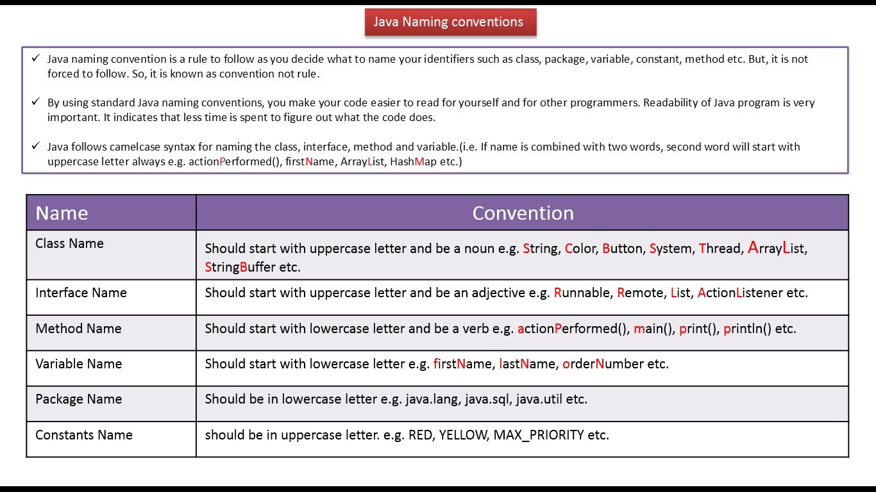
Basics of JAVA: Naming Convention

Slide 86
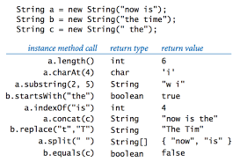
Basics of JAVA: String Class
String is a sequence of characters. In java, objects of String are immutable which means a constant and cannot be changed once created.
Creating a String
There are two ways to create string in Java:
String literal: String s = “GeeksforGeeks”;
Using new keyword: String s = new String (“GeeksforGeeks”);
Example: StringExample.java

Slide 87
Basics of JAVA: StringBuffer and StringBuilder class
The StringBuffer and StringBuilder classes are used when there is a necessity to make a lot of modifications to Strings of characters.
Unlike Strings, objects of type StringBuffer and String builder can be modified over and over again without leaving behind a lot of new unused objects.
The Java StringBuilder class is same as StringBuffer class except that it is non-synchronized. It is available since JDK 1.5.
Both have similar type of methods
Creating a String
StringBuffer sb = new StringBuffer(“Test");
StringBuilder sb1 = new StringBuilder(“Hello");
Example: StringBufferExample.java, StringBufferExample2.java, StringBuilderExample1.java, StringBuilderExample2.java

Slide 88
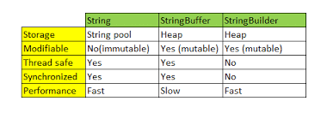
String Vs StringBuffer Vs StringBuilder class
Example: StringExample2.java

Slide 89
Basics of JAVA: StringBuffer and StringBuilder class
The StringBuffer and StringBuilder classes are used when there is a necessity to make a lot of modifications to Strings of characters.
Unlike Strings, objects of type StringBuffer and String builder can be modified over and over again without leaving behind a lot of new unused objects.
The Java StringBuilder class is same as StringBuffer class except that it is non-synchronized. It is available since JDK 1.5.
Both have similar type of methods
Creating a String
StringBuffer sb = new StringBuffer(“Test");
StringBuilder sb1 = new StringBuilder(“Hello");
Example: StringBufferExample.java, StringBufferExample2.java, StringBuilderExample1.java, StringBuilderExample2.java

Slide 90
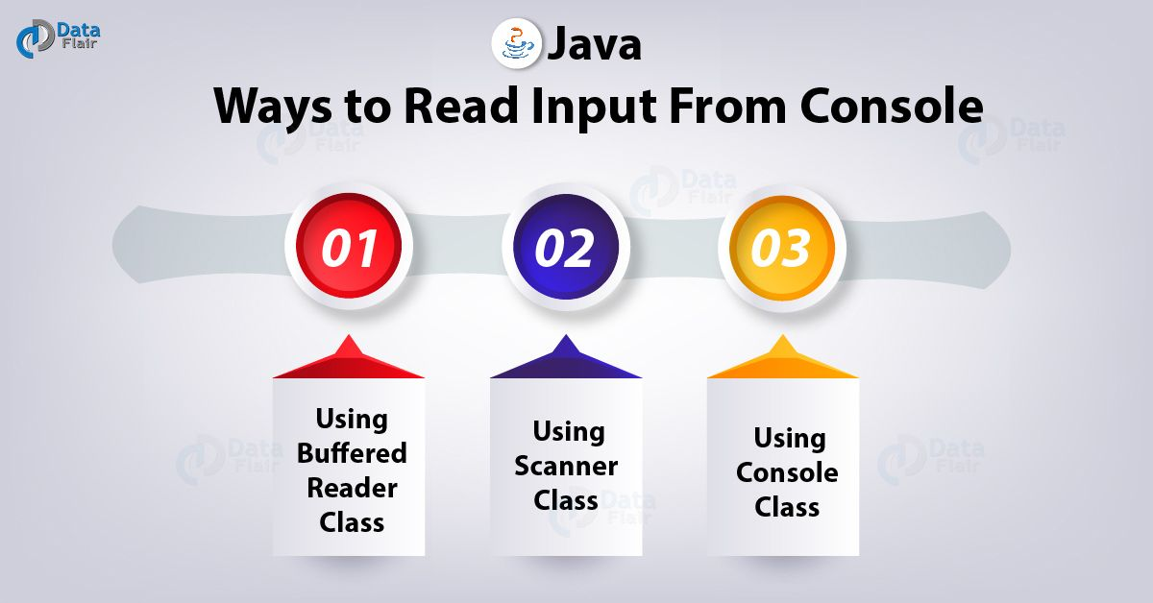
Basics of JAVA: Read Input from console

Slide 91
Basics of JAVA: Read Input from console
Scanner is a class in java.util package used for obtaining the input of the primitive types like int, double etc. and strings.
To create an object of Scanner class, we usually pass the predefined object System.in, which represents the standard input stream. We may pass an object of class File if we want to read input from a file.
To read numerical values of a certain data type XYZ, the function to use is nextXYZ(). For example, to read a value of type short, we can use nextShort()
To read strings, we use nextLine().
To read a single character, we use next().charAt(0). next() function returns the next token/word in the input as a string and charAt(0) funtion returns the first character in that string.
Example: ScannerDemo1.java, ScannerDemo2.java, ScannerDemo3.java

